Slide 1
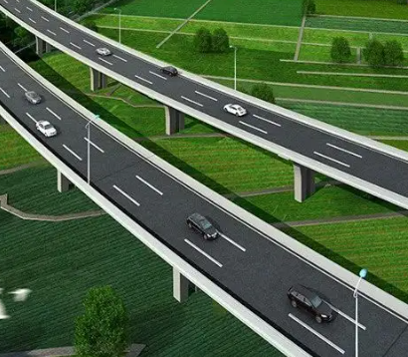
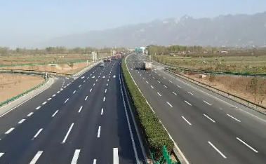
The Characteristics of Expressway Reconstruction and Extension Engineering in China
International Association of Chinese Infrastructure Professionals
THE 13th IACIP Annual Workshop:
Adaptive Infrastructure under Climate Change
Wenhao Dong, Chang’ an University, 245451068@qq.com.
Feng Ma, Chang’ an University, mafeng@chd.edu.cn.
Zhen Fu, Chang’ an University, zhenfu @chd.edu.cn.
Shuai Cheng, Qingdao Municipal Engineering Design Institute, 924331900@qq.com.
Introduction
Construction Type
Background:
In recent years, the global climate has changed significantly, and the requirement for traffic has also increased. The service level of some expressways can not meet the requirements.
Many provinces in China have gradually reconstructed and expanded the expressway, which has been a new hotspot.
The highway reconstruction and expansion project has outstanding characteristics different from the new expressway project.
Separate Widening
Splicing Widening
Expressway with poor geological conditions
One side
widening
Double side widening
Objectives:
This poster divided the main differences between highway reconstruction and new construction projects, and discussed the characteristics of highway reconstruction and expansion in various aspects. The purpose is to provide suggestions for the future construction of the reconstruction and expansion projects.
Technical Characteristics
Advantages
Advantages
① Alignment design
Low demolition work
Convenient traffic interaction
Content：
Plane design
Vertical design
Cross section design
No impact on the original traffic
Effective use of old roads
Principle：
Use the residual value of the original road
Small impact on road network
Flexible construction
Disadvantages
Reduce roadside land occupation
Disadvantages
Method：
multi-circle complex curve fitting
Segmental fitting
Nonuniform settlement
High construction cost
Additional splicing technology
② Splicing technology
Poor traffic connectivity
Restricted by the original road
Content：
Subgrade splicing
Pavement splicing
Bridge splicing
Economic Characteristics
Main point：
The connection of the subgrade soil
Control Compaction
Demolition
Complex
Control permeability
Joint reinforcement
Joint compaction
COST
Original road
Dynamic
③ Construction organization design
Objective：
Ensure normal construction
Ensure normal traffic operation
Conclusion
Reduce construction cost
Improve work efficiency
Separate widening and splicing widening have large differences in construction characteristics.
The technical characteristics and design methods should fully take into account the utilization of the old roads and not block the original road traffic.
It is necessary to reduce the high construction cost by reasonably planning the cost of land acquisition and demolition and increasing the utilization rate of the old road.
④ Traffic organization design
Objective：
Keep the original road traffic as smooth as possible
Adaptive Infrastructure under Climate Change
The 13th Annual Workshop of the International Association of Chinese Infrastructure Professionals (IACIP)
December 2022

